Slide 1
The Pitch
Creating a Sellable Business Plan Presentation

Slide 2
The Pitch
Investors are the primary audience
You must capture their attention in the first 60 seconds
An effective pitch is no more than16 slides
Delivered in no more than 8-15 minutes
Tell your story like a story
Help your audience get a picture in their heads.
Rehearse. Rehearse. Rehearse.

Slide 3
The Pitch: Table of Contents
Title Slide
Market Problem
Your Solution
Business Model & Sales
Market Demand
Competition
Growth Opportunity
Management Team
Financial Projections
Financial Projections Chart
Investment Strategy & Use of Funds
Example: Funding Sought/Valuation Chart
Company Milestones
Example: Company Milestones
ChartRisk Assessment
Risk Assessment
Exit Strategy
Rules for the Pitch
Key Questions to Answer
Resources:
Angel Capital Foundation • Angel Resource Institute • Ohio TechAngels
The Entrepreneur’s Handbook

Slide 4
1. Title Slide
Introduce yourself and your title
Feature company name/graphics
Deliver your two-line elevator pitch
Share a brief company history
Year founded & 1-2 sentences: e.g. “We founded XYZ in 2008 as a medical device company to commercialize uniquely effective wound treatment appliances. We have a working prototype and have filed our 510(k) application.”
State why you are there
Spend less than 2 minutes on this slide

Slide 5
2. Market Problem
Clearly communicate the “problem” in the market and lay the foundation for the following slides
Provide two example that relate to your solution’s “unfair advantage”
Include these key points
How do you know there is a “problem” in the market…
What are the market needs…
The cost of the problem…

Slide 6
3. Your Solution
Discuss how your product or service solves the marketplace problem for customers
Sprinkle in your personal experience from talking with customers
Do not get mired down in the technology
Focus on customer benefits
Include these key points:
Summarize your solution, emphasizing the
uniqueness of your product or technology
Match your solution to customers’ needs
Outline customers’ ROI, including the time to recoup
their investment
Describe protection for your product or solution
Notes:
Is it “Better/Faster/Cheaper” or a “Brave New World/Disruptive Technology?” Do you enable your customers to cut costs or generate more revenues? Are you selling a vitamin pill or an aspirin? What’s the current pain level, the inability of others to relieve it, and the cost of the pain in terms of dollars/time/inconvenience? Is buying your product/service an additive cost or does it replace other costs? If not solving a problem, then how unique and essential is the thrilling customer experience you plan to provide? Why is now a great time for your venture to be successful?

Slide 7
4. Business Model and Sales
Describe how your product or service
generates revenue for the company
Keep the explanation simple
Include these key points:
How do you charge?
What is your pricing strategy?
What is your channel strategy for reaching initial customers?

Slide 8
5. Market Demand
Quantify the market by size, segments, and sales
Avoid sky-high numbers
Characterize the key attributes of target customers
Show the urgency of the product or service needed
Notes:
Dimension your Total Global Market Size (i.e. with a 100% capture rate) & Growth Rate; Data from third party research organizations? Your Total Available Market (separate domestic & foreign); Your initial Targeted Market; What % capture is needed for Survival Cash Flow Break Even?

Slide 9
6. Competition
Create a comparison chart of competitors
Include large and small companies, those who are established and better know as well as the up-and-comers
Acknowledge the risk of inertia and status quo
Describe what it will take for customers to change
from what they are using today
Describe your strongest barriers
to competition
vs.
Your
Product or Service
Competition
Notes:
Their Size: If public, provide their Ticker symbol; If private, provide estimated revenues and amount/names of VC funding (if any); Their solutions & business model; Why is yours so superior? What’s your unique and unfair competitive advantage? Why is it sustainable? Presuming your toughest competitor has adequate funding to replicate your idea, how long will it take them to do so? What might be their combative reaction when they see your success?
Explain the difficulty and likelihood that your product can be knocked off in China (disregarding all IP laws).

Slide 10
7. Your Sales & Marketing Plan
Describe the company growth potential after initial launch
Direct Sales force? Channel Strategy? If selling through distributors, who has managed such channel partners in the past?
What’s your typical sales cycle?
explain Client Acquisition Cost vs. Lifetime Value;
Why will prospects buy?
Who must get into whose office and say what how many times before they buy?
Typical customer’s purchase approval process?
Is an off budget purchase decision likely?
Any seasonality due to budgeting?

Slide 11
7. Your Business Model
Sell @ what price?
Pricing Strategy; Disposables? Maintenance fees? Contract expiry?
Your recurring revenues?
Leasing Option?
How many of your products do they need?
Accounts Receivable or Credit Card?
Payment cycle/working capital model?
Average account/sale size?

Slide 12
8. Management Team
Show the strength of your team as individuals and evidence of how effectively you work as a team
Use concise bullet points to highlight key experience
Indicate full-time/part-time
Highlight Board of Advisors/Board of Directors
Include these key points:
Entrepreneurial experience
Years in target markets
Functional expertise
Experience with start-ups, acquisitions and IPO’s

Slide 13
8. Your Current Status
Sales to date (in # of units, clients, & not just revenue $);
Strategic/channel partners?
Highlight customers?
Testimonials?
Compare pipeline to sales needed to achieve Cash Flow Break Even;

Slide 14
9. Financial Projection
Focus on the bottom line. How much capital is needed to reach breakeven and profitability?
Match critical milestones to capital needs
Base projections on assumptions generated from market study and analysis
Project realistic revenues
You must be able to explain:
Margins greater than the norm
Monthly Burn Rate
Extended periods of negative cash flow

Slide 15
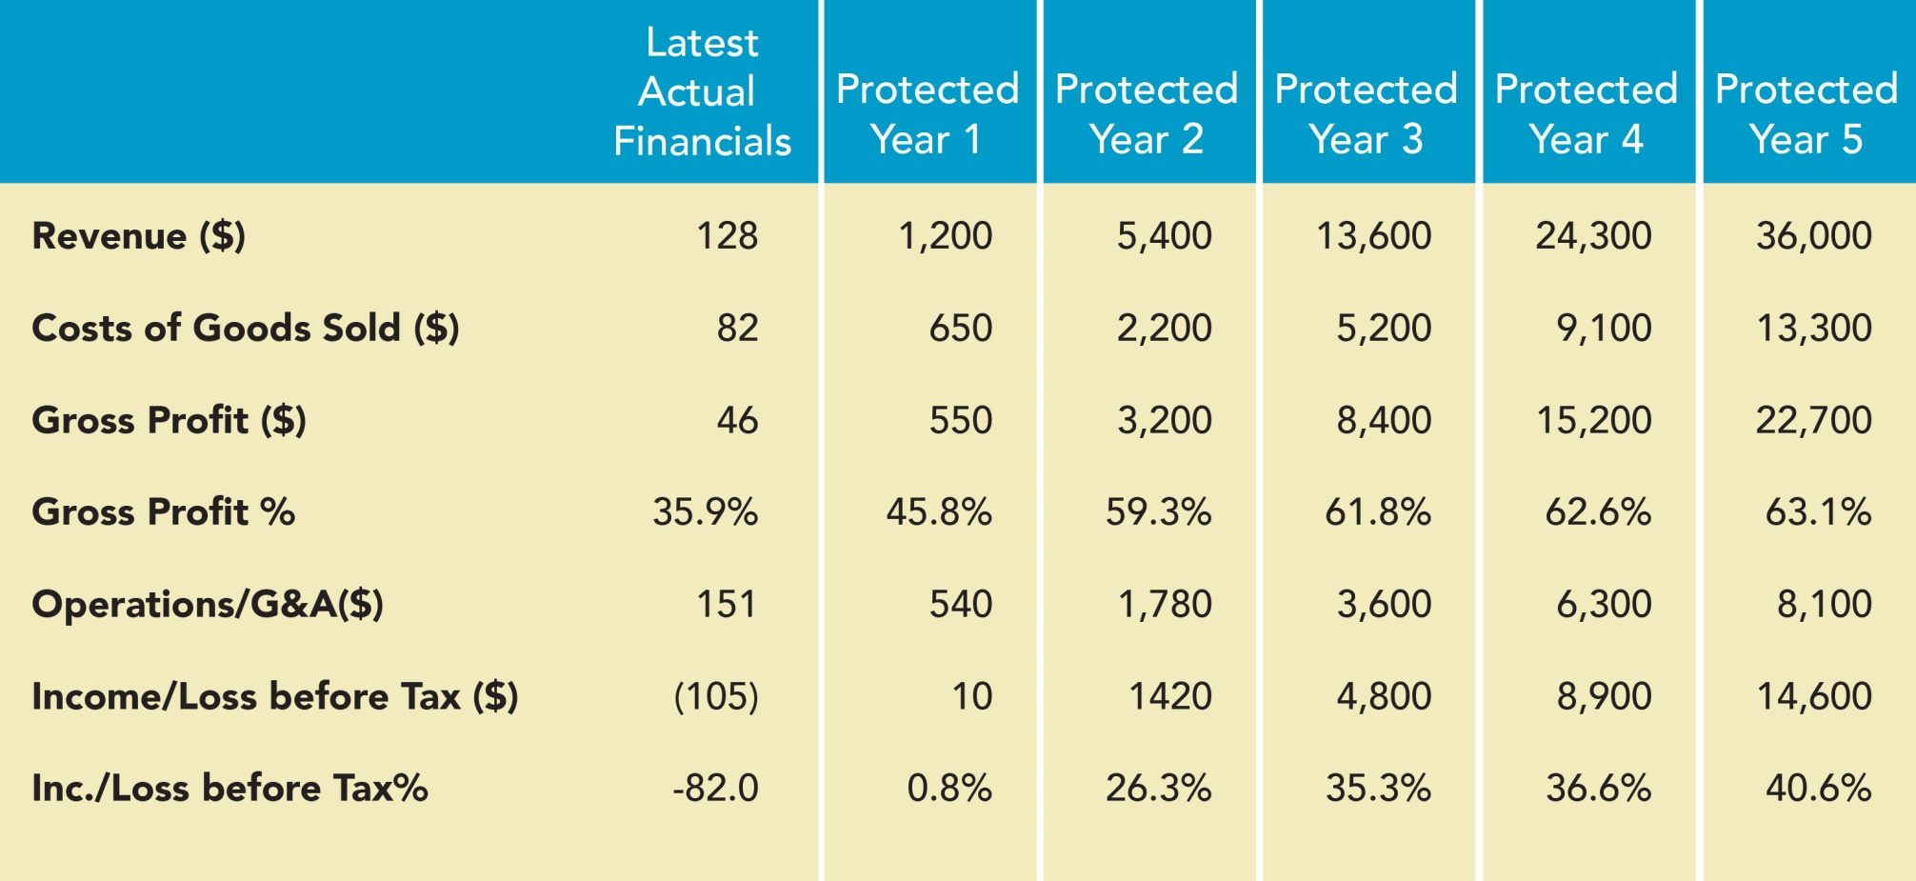
10. Example: Financial Analysis

Slide 16
11. Investment Strategy and
Uses of Funds
Form of investment
How much are you looking for?
what valuation?
Use of Proceeds (not just how spent, but the milestones achieved prior to next round);
What future funding will be required, and when
What non cash assistance do you wish from your investors?

Slide 17
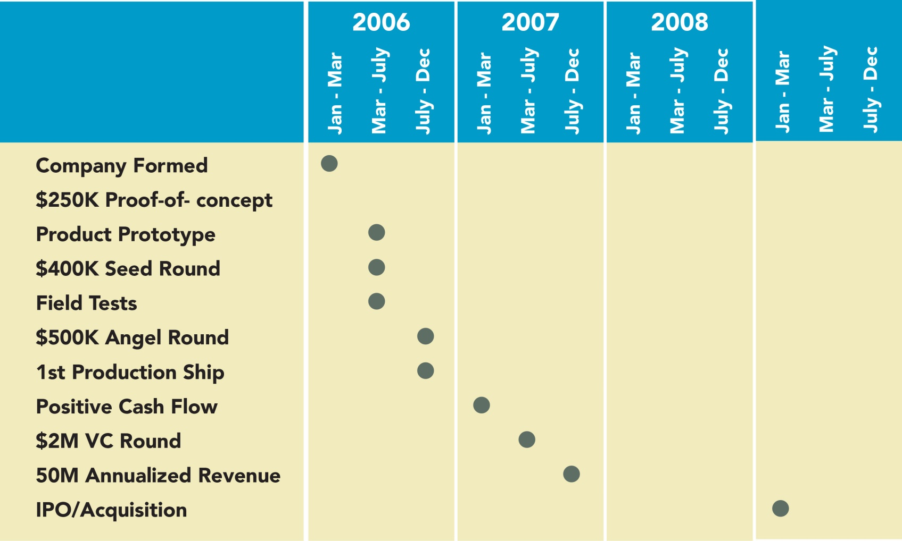
14. Example: Company Milestones Chart

Slide 18
15. Risk Assessment
Potential investors know that entrepreneurial companies are risky
Share your risk assessment with potential investors as honestly as possible
Segment risk by product, market, operation, finance, and execution
Strike a balance between optimism and realism

Slide 19
16. Liquidity
Realistically relay the specifics of your exit options
Acquisition
Identify potential buyers and why they would be interested
Describe recent comparable transactions
Express any current relationships with potential acquirers
IPO
Describe recent comparable offerings
Be prepared to explain why your company could be an IPO candidate

Slide 20
Rules for the Pitch
Allow a reference to arrange the meeting
Rehearse. Rehearse. Rehearse
Target the right audience—there are big differences between
partners, angels and VCs
Show up early and only bring key personnel
Business attire only
Use appropriate social skills, no off-color jokes
Know your stuff
Be enthusiastic but not annoying
Be courteous and respectful
Don't read to the audience
Use simple pictures, graphics and avoid extremely abbreviated text
Use 4 bullets per page, and 4 words per bullet
Let the audience know how your business makes money
Be prepared to answer questions
Be open to audience recommendations

Slide 21
Be Prepared to Answer these Questions
What problem does your company solve?
Who is the target user of the product or service offering?
Why would someone purchase your product or service?
What is the market potential for your company's product or service?
How do you plan to acquire and keep customers?
Who are your competitors?
What gives your company a competitive advantage?
What makes your business different or unique?
Does your company have proprietary intellectual property?
What is the planned “Use of Funds"?
When will the company reach break even?
What are the primary risks facing your business opportunity?
What is it about your management team that makes it uniquely capable
of executing on this business plan?
What are the exit scenarios for the founders and investors?

Slide 22
Words You Never Want to Say!
This is the best deal you will ever see
No one else does what we do
We are chasing billion dollar markets
Our intellectual property is solid
We don’t have any competition.
Big corporations are too slow to be a threat
Our financial projections are conservative
We just need a 1 to 2 percent market share to
meet our projections
Our margins exceed 10 percent
A big corporate partner is about to sign on
Key employees will join us at funding
Revenues are not out current focus
And the ultimate turn-off:
Several VCs and angels are interested in funding our plan

